Slide 1
Event Driven Programming and GUIs Part 3
CS221 – 4/15/09

Slide 2
Professional Assignments
Assignment #2 – Download and install Visual Studio 2008 Professional Trial Software
http://www.microsoft.com/downloads/details.aspx?FamilyID=83c3a1ec-ed72-4a79-8961-25635db0192b&displaylang=en
Assignment #3 – Implement any one of your sorting algorithms using C# instead of Java
To get credit for both assignments:
Send me your working C# project in email
If it compiles and works you’ll get full credit

Slide 3
GUI Programming - Key Points
The point is to make the application you are creating easier to use
Don’t think of the UI as the solution, but as the human interface to the solution you are providing
You don’t have to create from scratch, Java gives you many controls to reuse

Slide 4
GUI Programming is Different
To create a simple UI is relatively easy
To create a good UI requires:
Programming skills
Layout skills
Human/Computer interface skills
There are not many people who can do it all!
Good GUI programming is a matter of practice and using good user interface principles

Slide 5
Imitation is a good Approach
How to get better:
Study programs that do a good job with UI. How do they do it?
Read books on UI programming and human/computer interface techniques
Review the built in class libraries and controls. Understand what’s available vs. what you may need to create from scratch
Practice! Whenever you can, build a GUI for your programs

Slide 6
JFrame
One way to create a GUI is to extend JFrame
http://java.sun.com/j2se/1.4.2/docs/api/javax/swing/JFrame.html
JFrame gives you:
A visible UI window in which you can place buttons, form fields, menus, and other UI elements.
Handles events for close, minimize and maximize.
Resizes for you.
That’s pretty much it!

Slide 7
Extending JFrame
How do we make a simple GUI extending JFrame?
Create a package
Create a class, extends JFrame
Import javax.swing.*
Create a constructor
setVisible(true);
Create main and call the constructor

Slide 8
What do we get?
Kinda lame so far…
But it does draw itself, minimize, maximize, resize and close
Not bad for so little effort actually!

Slide 9
Hello World
Let’s turn it into a Hello World application
That’s exciting right?
What do we need to do?
Add some text
Make sure it actually closes on exit…

Slide 10
Hello World
To add text:
Add a JLabel field
Set the value of the label field
Add it to the frame
Ensure the application closes:
setDefaultCloseOperation(JFrame.EXIT_ON_CLOSE);

Slide 11
What do we get?
Still boring… let’s add some interactivity
How about we allow the user to set the text?

Slide 12
Hello World Revised
We need to:
Add an input field
JTextField
Give the user a button to click
JButton
Update the label with the contents of the input field when the button is clicked

Slide 13
Layout
After we add the controls, they aren’t visible on the frame…
We need to arrange the controls in the frame so they aren’t on top of each other
We need to make sure the frame is big enough to display everything

Slide 14
Layout
In order to layout the UI controls on the frame we need to use a layout manager
A layout manager controls the size and location of the UI elements based on
Layout manager rules
Parameters you pass in governing those rules
A frame can contain
Controls, such as buttons and fields
Containers, that contain other controls
Each container can have its own layout manager

Slide 15
Layout Managers
Border Layout
Lay out controls in a header, footer, margins or center
Assign each control to North, South, East and West
Flow Layout
Flows the controls onto the screen from left to right
Chooses number of rows based on width of panel, number of controls and the size of each
Card Layout
Allows you to show some controls and keep others hidden
You can toggle what you display based on user input
Grid Layout
Lay out controls in a grid format with a specified number of rows and colums
GridBag Layout
Like grid layout but it gives you more options to change the size of elements, etc

Slide 16
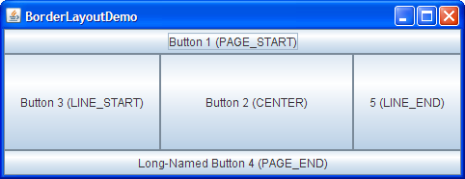
Border Layout

Slide 17

Flow Layout

Slide 18
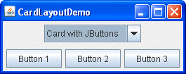
Card Layout

Slide 19
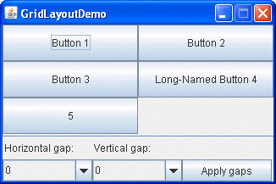
Grid Layout

Slide 20
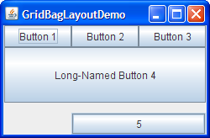
Gridbag Layout

Slide 21
Back to our Layout
To layout the UI elements on the frame:
Set layout on the frame
getContentPane.setLayout()
Pass in a layout manager
GridLayout(3, 1), will create a grid layout of 3 rows and 1 column
To make sure the window is big enough
Call pack() to resize the window

Slide 22
Handling the Button Click
To handle the click we:
Create an action listener class
public class AL implements ActionListener
Add the action listener to the button
Button.addActionListener()
Handle the click in our action listener class
public void actionPerformed(ActionEvent e)
If e.getActionCommand()==“…”

Slide 23
Let’s look at the lab code
Why do we use panels?
Why are we setting the size of some controls but not others?
Notice how we handle multiple event types in a single listener

Slide 24
Improving FlightsWindow
How would we:
Add a button that when pressed would add a flight?
Sort the flight list when the user clicks the sort button?
Add another row of UI elements for new functionality?

Slide 25
